Slide 2
who we are…
Morehouse College is the nation’s only historically black, private, liberal arts college for men. Located in Atlanta, Georgia
The Atlanta University Center Consortium is the largest contiguous consortium of African Americans in higher education in the United States.
Accredited by the Southern Association of Colleges and Schools
Founded 1867
14:1 Student to Teacher Ratio
Total enrollment of 2,200 students, representing more than 46 states and 22 countries
All tenured professors have terminal degrees, and teach their own classes

Slide 3
The Numbers don’t lie…
Historically, Morehouse has conferred more bachelor's degrees on black males than any other institution in the nation.
Morehouse is one of only four Historically Black Colleges ranked in the Top Tier among the nation's Best Liberal Arts Colleges.
Morehouse is the top feeder school for African American men who enter Harvard Business and Law Schools.
Morehouse College is the largest producer of African American men who eventually earned PhDs in the fields of Science, Technology, Engineering, and Mathematics.
Variety Magazine recently named Morehouse’s CTEMS (Cinema, Television and Emerging Media Studies) Program as one of the best film schools of 2019.
Morehouse has produced the third-highest amount of black venture capitalists. More than Yale and Penn, and only trailing Stanford and Harvard.

Slide 4
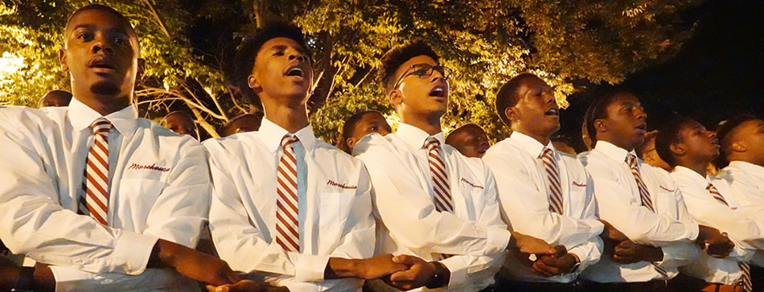
WHY MOREHOUSE?
You will work hard and rise to meet the highest expectations. Dr. Robert Franklin (10th Morehouse President) said that a Morehouse Man must graduate satisfying the 5 Wells of Leadership (Well-read, Well-spoken, Well-traveled, Well-dressed and Well-balanced).
You will join a brotherhood and worldwide professional (and lifelong) network of over 17,000 Morehouse Men. Being a Morehouse Man means something.
Morehouse is an environment where you will be protected, supported, inspired and challenged. Morehouse Men are built to excel and LEAD.

Slide 5
NOTABLE MOREHOUSE MEN

Slide 6
Samuel l. Jackson ‘72
Academy Award Nominee, Stage and Film Actor
Django Unchained
Pulp Fiction
A Time to Kill
Eve’s Bayou

Slide 7
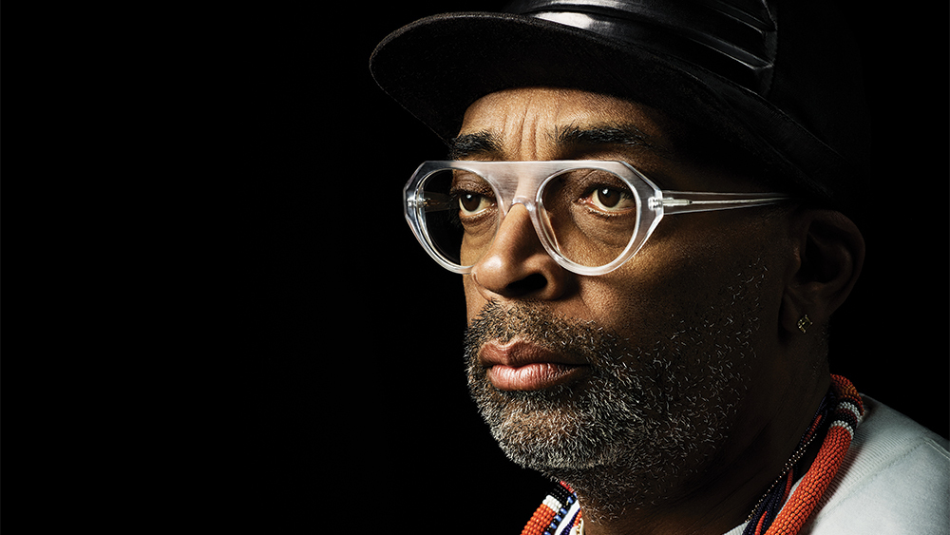
Shelton “Spike” lee ‘82
Academy Award Winning Filmmaker
School Daze
Do The Right Thing
Malcolm X
Black KkKlansman

Slide 8
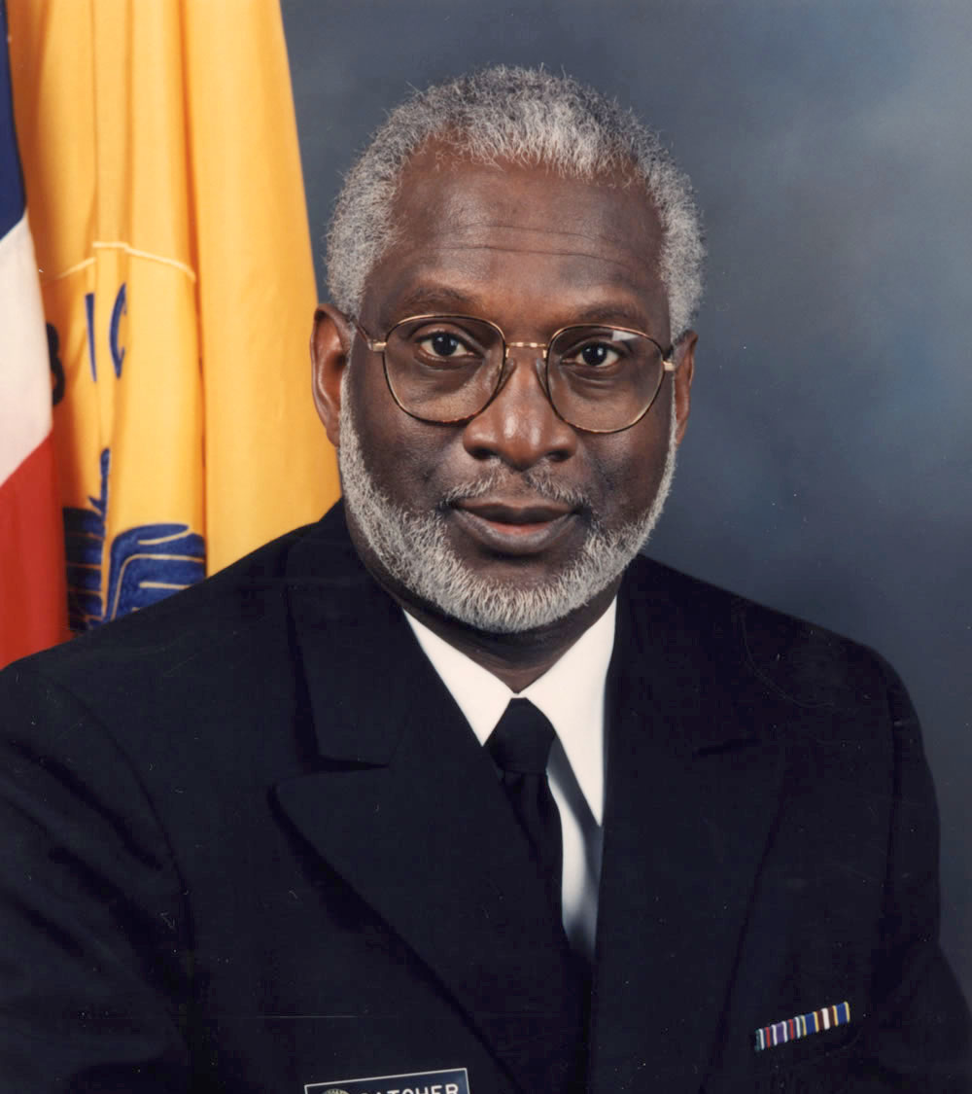
David Satcher, M.D., Ph.D ‘63
13th Director of the Centers for Disease Control and Prevention (CDC)
16th Surgeon General of the United States
Served simultaneously in the positions of Surgeon General and Assistant Secretary for Health from 1998 to 2001 at the US Department of Health and Human Services

Slide 9
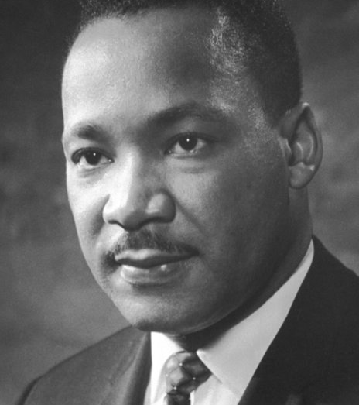
Dr. Martin Luther King, jr. ‘48
Minister and Activist
Nobel Peace Prize Laureate
Leader in the Civil Rights Movement

Slide 10
Academic Divisions AND MAJORS
Below are the academic divisions and majors at Morehouse College:
Humanities
Life Sciences
Business Administration & Economics
Business Administration (with concentrations in Accounting, Finance, Management and Marketing)
Economics
Africana Studies
History
Religion
English
Philosophy
Biology
Psychology
Kinesiology
Chemistry

Slide 11
Academic Divisions AND MAJORS
Creative & Performing Arts
Social Science &
Cultural Studies
Mathematics and Computational Sciences
Music
Art
Art History Curatorial Studies
Drama
Dance
CTEMS (Cinema, Television and Emerging Media Studies)
Urban Studies
Political Science
Chinese Studies
Spanish
French
Sociology
Communication Studies
Mathematics
Pre-Engineering
Computer Science
Physics

Slide 12
Academic Divisions AND MAJORS
Experiential Learning and Interdisciplinary Studies
Software Engineering

Slide 13
How to become a man of morehouse
Admissions Requirements
How to apply
Deadlines

Slide 14
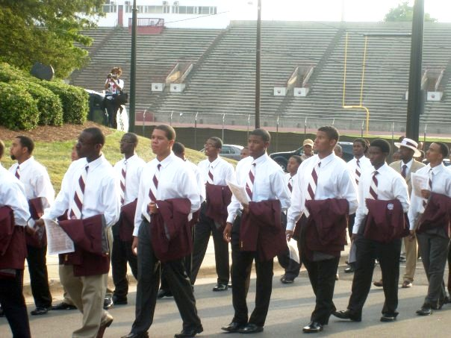
Key Stats for Interested Students
Statistics
Approx. Total Cost (per year) | $49,700
Avg GPA on a 4.0 scale (weighted) | 3.6
Avg SAT score/Avg SAT for Honors Program | 1110/1260
Avg ACT/Avg ACT for Honors Program | 24/27
Range of Students Enrolled | 2,000-2,500
Number of 1st year Freshmen Enrolled Annually | 650-700
Campus Tours (*temporarily suspended) | Yes*
1st Year Live on Campus Requirement | Yes
Acceptance of Transfer Students | Yes

Slide 15
How to apply
MOREHOUSE COLLEGE’S APPLICATION IS EXCLUSIVELY AVAILABLE VIA THE COMMONAPP
PLEASE VISIT https://www.commonapp.org/explore/morehouse-college

Slide 16
Admissions requirements/DEADLINES
Traditional Freshman Applicant
Complete Your Application via Common App
$50 non-refundable application fee
Official High School Transcript
2 Letters of Recommendation
Official SAT/ACT scores (Morehouse superscores for the SAT but not the ACT)
NEW Test-Optional policy
HIGHLY ENCOURAGED - Student Interview (Zeemee.com)
Early Action Deadine for Fall 2021
November 1st (expired)
Regular Action Deadline for Fall 2021
February 1st
Notification Dates
Early Action - December 15th
Regular Action - February 15th & March 15th
FYI - An applicant that is not admitted during early action would automatically be deferred and have their application reviewed again for regular action.

Slide 17
Admissions requirements
Test-Optional Admissions Policy FAQ’s
Without the submission of test scores, how will you evaluate my application?
Morehouse will not penalize applications without test scores. However, we encourage you to highlight other parts of your high school career (i.e. high GPA, consistent record of academic rigor, dual enrollment/college coursework, membership/leadership in school clubs, athletics, volunteer work, social justice involvement, internships or employment). We also understand that access to traditional extracurricular activities may be limited this year, so write about your involvement throughout your entire high school career.
Am I eligible for merit-based scholarships without test scores?
Yes. If you do not submit test scores, you are eligible for merit-based scholarships. However, there are still some scholarships that require test scores that predate the adoption of the test-optional policy.

Slide 18
COST OF ATTENDANCE AND FINANCIAL ASSISTANCE
TOTAL COST OF ATTENDANCE IS $49,700
(per year)
Scholarship Programs at Morehouse
(Oprah Winfrey Endowed Scholarship Program - https://www.morehouse.edu/oprah/summaries.html)
Available Financial Aid
(https://www.morehouse.edu/financialaid/availableaid.html)
Athletic Scholarships
External Scholarships https://www.morehouse.edu/financialaid/links.html
Federal Student Aid
Free Application for Federal Student Aid (FAFSA)
FAFSA.ED.GOV

Slide 19
SCHOLARSHIPS
Morehouse Bonner Scholars Program https://www.morehouse.edu/bonner/BonnerScholarsProgram.html
Oprah Winfrey Endowed Scholarships Program at Morehouse https://www.morehouse.edu/oprah/summaries.html
Dr. Michael L. Lomax Student Success Scholarship (named after UNCF chief executive and 1968 Morehouse graduate)
External scholarships applicable to Morehouse https://www.morehouse.edu/financialaid/links.html
UNCF Scholarships - https://uncf.org/scholarships
Tom Joyner Foundation https://tomjoynerfoundation.org/scholarships-list/
Thurgood Marshall Scholarships https://www.tmcf.org/students-alumni/scholarships/
Coca-Cola Scholarship - https://www.coca-colascholarsfoundation.org/apply/
HBCU Scholarships https://www.affordablecollegesonline.org/college-resource-center/hbcu-scholarships/

Slide 20
Scholar Snapp - A free, simple to use data standard that allows students to reuse their application information - including contact information, essays, transcripts, etc. - from one scholarship application to another thereby streamlining the college scholarship application process.
Scholly – A mobile app that provides students with a fast and simple way to find scholarships for college.
Peerlift - Proven scholarships, internships, summer programs, and more gathered by fellow students like you.
Fastweb – Create a profile and let fastweb do the research on scholarships, internships colleges and more for you.
Common Knowledge Scholarship Foundation – Educational and scholarship opportunities for students of all levels.
Scholarships.com – A free college scholarship search and financial aid information.
Scholarship America – Provides information and resources for your scholarship search.
Gates Millennium Scholars – Provides outstanding low income African American, American Indian/Alaska Native, Asian Pacific Islander American, and Hispanic American students with an opportunity to complete an undergraduate college education in any discipline they choose.
Dell Scholars Program – Recognizes academic potential and determination in students that have a definite need for financial assistance.
Reagan Foundation Scholarships - Scholarship opportunities for outstanding student leaders.
The NSHSS Foundation - The NSHSS Foundation fosters the growth of students pursuing the STEAM (science, technology, engineering, arts, and math), business, economics, public policy, and environmental science and sustainability fields.
The College Board Opportunity Scholarships - The program guides juniors and seniors through the college planning process and offers the chance to earn scholarships, from $500 to $40,000, for every action that students complete.

Slide 21
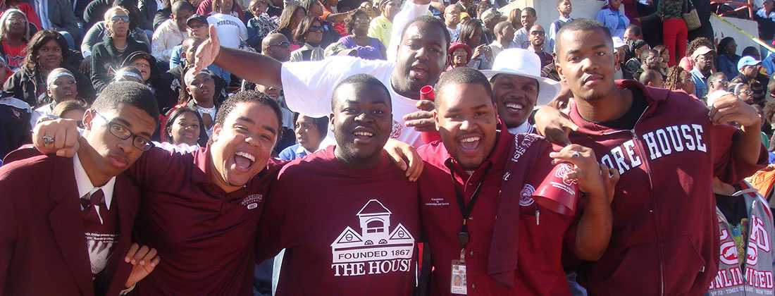
Campus life
Crown Forum, Andrew Young Center for Global Leadership
Social Events (Hump Wednesdays, Market Fridays @Spelman, Spring Fest, Pageants, Homecoming Week Events, Step Shows)
Over 70 clubs (NSBE, Achieve More, Lytehouse, Morehouse Business Association Protégé’ Program)
Greek Life
Marching Band, Glee Club, Debate Team, Jazz Ensemble, CASA (Campus Alliance of Student Activities)
Student Government Association (SGA), Student Ambassadors
Intramural Sports

Slide 22
Athletics
morehouseathletics.com
Morehouse College Maroon Tigers are a member of the Southern Intercollegiate Athletic Conference (SIAC). Morehouse offers the following sports at the NCAA Division II level:
Football
Basketball
Baseball
Track & Field
Golf
Tennis
Cross Country
Volleyball* (PENDING* Fall 2021)

Slide 23
Alvin N. Conteh Assistant Director of Admissions & Recruitment alvin.conteh@morehouse.edu Office: (470)639-0947
Morehouse.edu
Morehouseathletics.com
Complete our student inquiry form HERE - https://slate.morehouse.edu/register/?id=02e762c5-f1ae-4504-a504-e71fde8a354f
WANT TO APPLY? START HERE -
https://www.commonapp.org/explore/morehouse-college

Slide 24
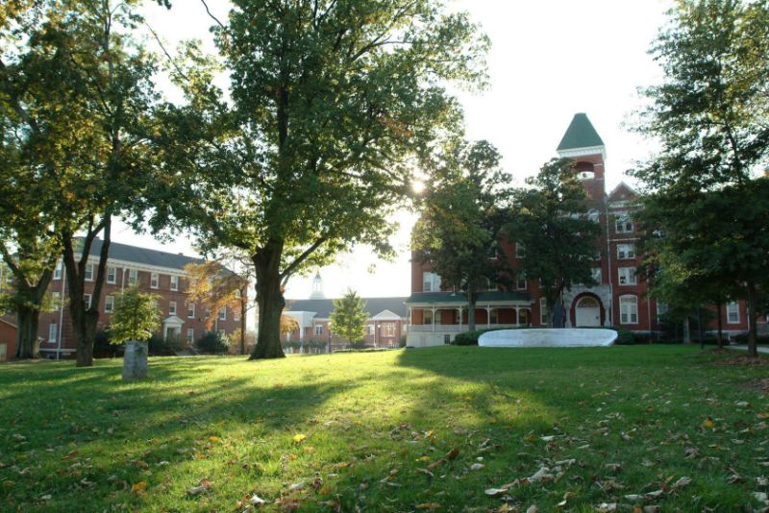
Question & answer session

